Slide 1
Transaction Management

Slide 2
Transaction Concept
A transaction must be a logical unit of work. That is, no portion of a transaction stands by itself.
For example, transaction to transfer $50 from account A to account B:
read(A)
A := A – 50
write(A)
read(B)
B := B + 50
write(B)
Two main issues to deal with:
Recovery: Failures of various kinds, such as hardware failures and system crashes
Concurrent: execution of multiple transactions

Slide 3
Transaction Concept
A transaction must take a database from one consistent state to another. Therefore, all parts of a transaction must be executed, or the transaction must be aborted.
A consistent state of the database is one in which all data integrity constraints are satisfied.
For example, transaction to transfer $50 from account A to account B:
read(A)
A := A – 50
write(A)
read(B)
B := B + 50
write(B)
Account A
$300
Account A
$250
Account B
$200
Account B
$250
A + B = $500
A + B = $500

Slide 4
Transaction: Example
Enroll a student
Vikas to MCAC202
steps:
start
check to see if student “Vikas" exists… read only
check to see if class “MCAC202" exists.. read only
access enrollment table .. read only
update enrollment table ..make changes (update)
access student record/table read only
update student table ..make changes (update)
commit transaction
end

Slide 5
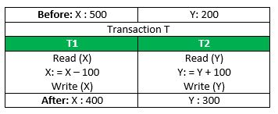
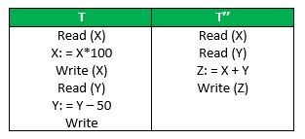
Principles of Transaction
ATOMICITY
all or nothing
CONSISTENCY
no violation of integrity constraints
ISOLATION
All the transactions will be carried out and executed as if it is the only transaction in the system.
The result of the concurrent databases execution of transactions is the same as though the transactions were executed in serial order.
DURABILITY
committed updates persist
Consider the following transaction T consisting of T1 and T2: Transfer of 100 from account X to account Y.

Slide 6
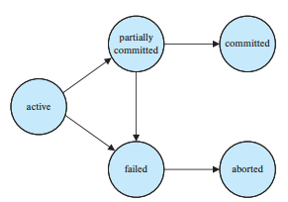
Transaction State
Active, the initial state; the transaction stays in this state while it is executing
Partially committed, after the final statement has been executed.
Failed, after the discovery that normal execution can no longer proceed.
Aborted, after the transaction has been rolled back and the database restored to its state prior to the start of the transaction. Two options after it has been aborted:
restart the transaction – only if no internal logical error
kill the transaction
Committed, after successful completion.

Slide 7
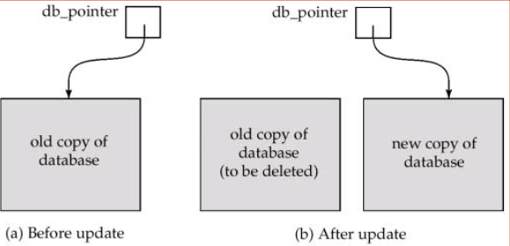
Implementation of Atomicity and Durability
The shadow-database scheme:
assume that only one transaction is active at a time.
a pointer called db_pointer always points to the current consistent copy of the database.
all updates are made on a shadow copy of the database, and db_pointer is made to point to the updated shadow copy only after the transaction is completed.
in case transaction fails, old consistent copy pointed by db_pointer can be used, and the shadow copy can be deleted.

Slide 8
Concurrent Executions
Multiple transactions are allowed to run concurrently in the system. Advantages are:
increased processor and disk utilization, leading to better transaction throughput: one transaction can be using the CPU while another is reading from or writing to the disk
reduced average response time for transactions: short transactions need not wait behind long ones
Concurrency control schemes
mechanisms to achieve isolation, i.e., to control the interaction among the concurrent transactions in order to prevent them from destroying the consistency of the database

Slide 9
Schedules
Sequences that indicate the chronological order in which instructions of concurrent transactions are executed
a schedule for a set of transactions must consist of all instructions of those transactions
must preserve the order in which the instructions appear in each individual transaction.

Slide 10
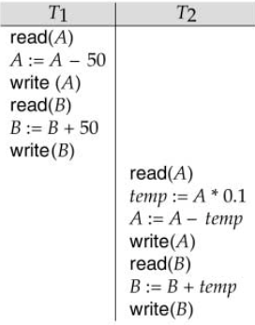
Example Schedules
Let T1 transfer $50 from A to B, and T2 transfer 10% of the balance from A to B. The following is a serial schedule, in which T1 is followed by T2
A=$1000, B=$2000
A=$855, B=$2145

Slide 11
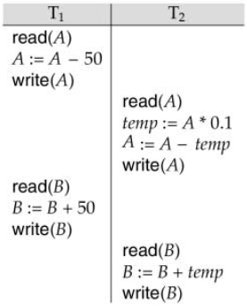
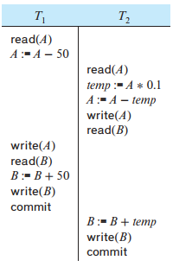
Example Schedule
Let T1 and T2 be the transactions defined previously. The following schedule is not a serial schedule, but it is equivalent to the previous Schedule. In both Schedules, the sum A + B is preserved.
Not all concurrent executions result in a correct state.
A=$1000, B=$2000
A=$1000, B=$2000
A=$855, B=$2145
A=$950, B=$2100

Slide 12
Issues with Concurrency: Example
Transaction T1: Transfer 100 from A to B
A = 500, B = 500, C = 500
Read (A, t)
t = t - 100
Write (A, t)
Read (B, t)
t = t + 100
Write (B, t)
A = 400, B = 600, C = 500

Slide 13
Issues with Concurrency: Example
Transaction T2: Transfer 100 from A to C
Read (A, s)
s = s - 100
Write (A, s)
Read (C, s)
s = s + 100
Write (C, s)

Slide 14
Transaction T1
Transaction T2
A
B
C
500
500
500
Read (A, t)
t = t - 100
Read (A, s)
s = s - 100
Write (A, s)
400
500
500
Write (A, t)
400
500
500
Read (B, t)
t = t + 100
Write (B, t)
400
600
500
Read (C, s)
s = s + 100
Write (C, s)
400
600
600
400 + 600 + 600 = 1600

Slide 15
Transaction T1
Transaction T2
A
B
C
500
500
500
Read (A, t)
t = t - 100
Write (A, t)
400
500
500
Read (A, s)
s = s - 100
Write (A, s)
300
500
500
Read (B, t)
t = t + 100
Write (B, t)
300
600
500
Read (C, s)
s = s + 100
Write (C, s)
300
600
600
300 + 600 + 600 = 1500

Slide 16
Serializability
We can ensure consistency of the database under concurrent execution by making sure that, the schedule should, in some sense, be equivalent to a serial schedule.
Such schedules are called serializable schedules

Slide 17
Serializability
Basic Assumption
Each transaction preserves database consistency.
Thus, serial execution of a set of transactions preserves database consistency.
A (possibly concurrent) schedule is serializable if it is equivalent to a serial schedule.
Different forms of schedule equivalence give rise to the notions of:
conflict serializability
view serializability

Slide 18
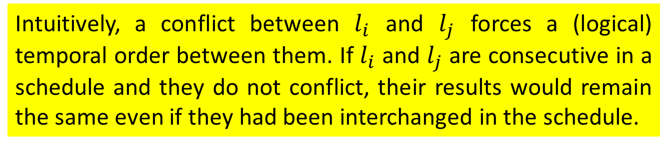
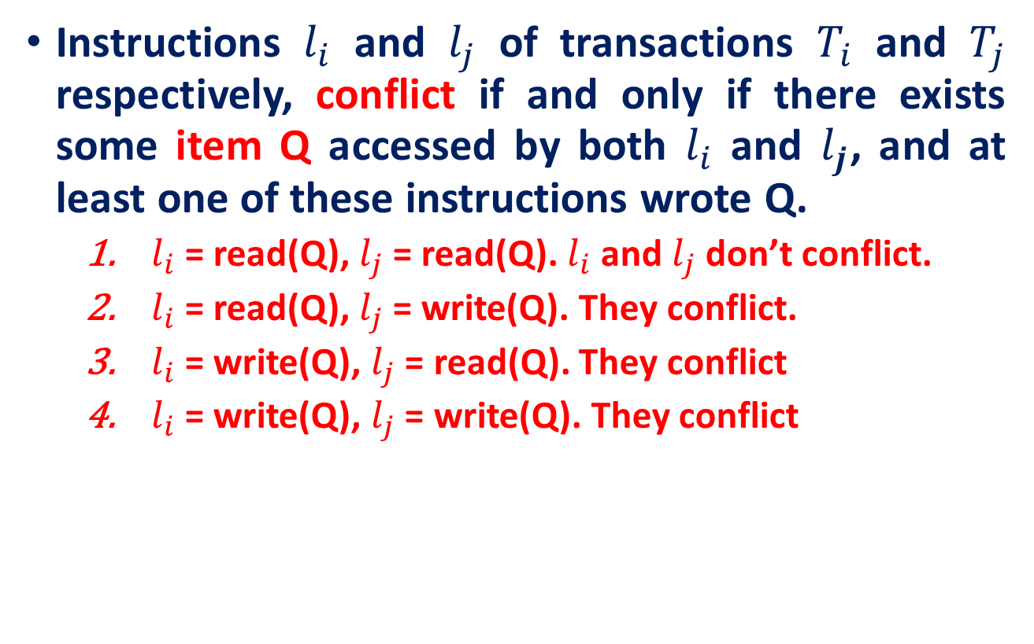
Conflict Serializability
Instructions $l_{i}$ and $l_{j}$ of transactions $T_{i}$ and $T_{j}$ respectively, conflict if and only if there exists some item Q accessed by both $l_{i}$ and $l_{j}$, and at least one of these instructions wrote Q.
$l_{i}$ = read(Q), $l_{j}$ = read(Q). $l_{i}$ and $l_{j}$ don’t conflict.
$l_{i}$ = read(Q), $l_{j}$ = write(Q). They conflict.
$l_{i}$ = write(Q), $l_{j}$ = read(Q). They conflict
$l_{i}$ = write(Q), $l_{j}$ = write(Q). They conflict
Intuitively, a conflict between $l_{i}$ and $l_{j}$ forces a (logical) temporal order between them. If $l_{i}$ and $l_{j}$ are consecutive in a schedule and they do not conflict, their results would remain the same even if they had been interchanged in the schedule.

Slide 19
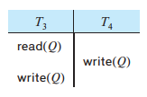
Conflict Serializability
If a schedule S can be transformed into a schedule S´ by a series of swaps of non-conflicting instructions, we say that S and S´ are conflict equivalent.
We say that a schedule S is conflict serializable if it is conflict equivalent to a serial schedule
Example of a schedule that is not conflict serializable:
We are unable to swap instructions in the above schedule to obtain either the serial schedule <T3, T4>, or the serial schedule <T4, T3 >

Slide 20
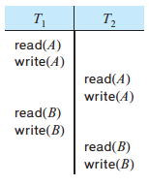
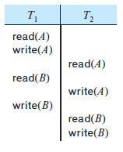
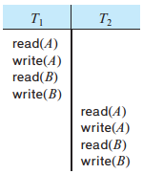
Conflict Serializability
Schedule below can be transformed into a serial schedule where T2 follows T1, by series of swaps of non-conflicting instructions. Therefore the below Schedule is conflict serializable
read(A)
read(A)
write(A)
read(B)
read(B)
write(B)

Slide 21
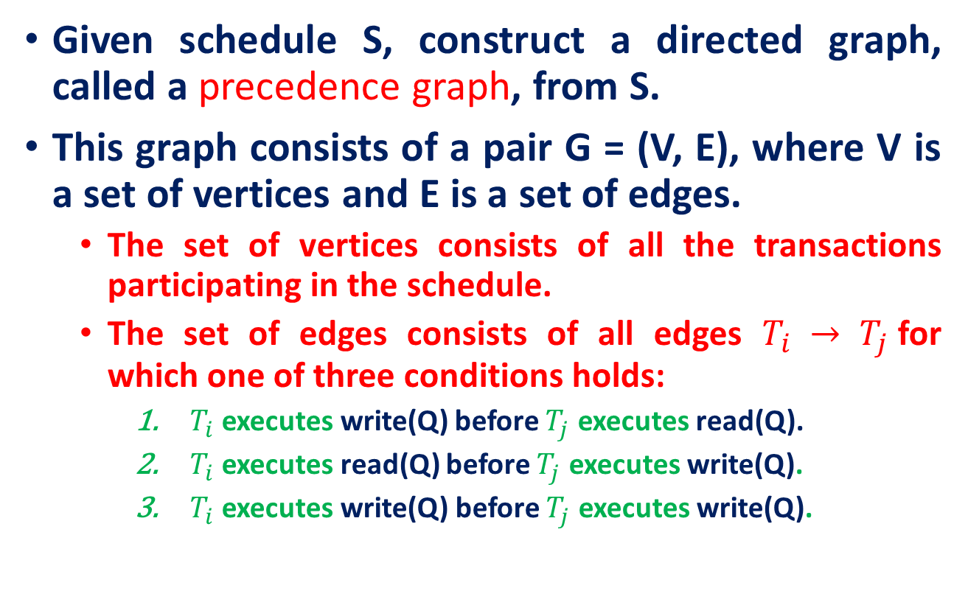
Checking Conflict Serializability
Given schedule S, construct a directed graph, called a precedence graph, from S.
This graph consists of a pair G = (V, E), where V is a set of vertices and E is a set of edges.
The set of vertices consists of all the transactions participating in the schedule.
The set of edges consists of all edges $T_{i} → T_{j}$for which one of three conditions holds:
$T_{i}$executes write(Q) before $T_{j}$ executes read(Q).
$T_{i}$ executes read(Q) before $T_{j}$ executes write(Q).
$T_{i}$ executes write(Q) before $T_{j}$ executes write(Q).

Slide 22
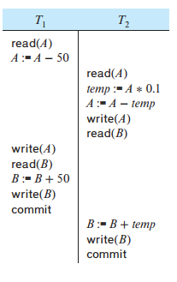
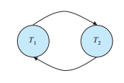
Checking Conflict Serializability
The precedence graph for schedule given beside appears below.
It contains the edge T1→ T2 because T1 executes read(A) before T2 executes write(A).
It also contains the edge T2 → T1 because T2 executes read(B) before T1 executes write(B)
If the precedence graph for S has a cycle, then schedule S is not conflict serializable. If the graph contains no cycles, then the schedule S is conflict serializable

Slide 23
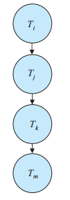

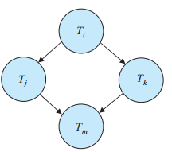
Topological sorting.
Method for obtaining a serializability order of the transactions by finding a linear order consistent with the partial order of the precedence graph.
There are, in general, several possible linear orders that can be obtained through a topological sort.

Slide 24
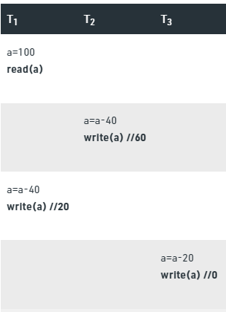
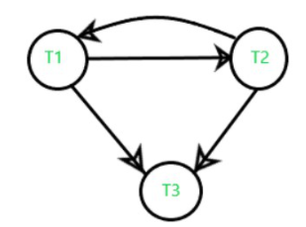
View Serializability
Conflict Precedence Graph
The above graph contains cycle/loop which means it is not conflict-serializable but it does not mean that it cannot be consistent and equivalent to the serial schedule it may or may not be.

Slide 25
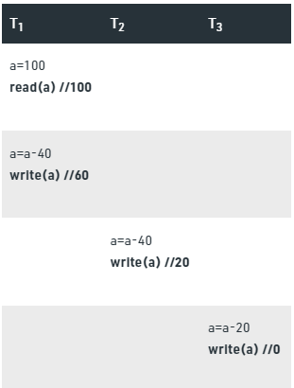
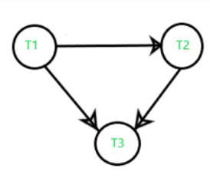
View Serializability
does not contain any cycle/loop, which means it is conflict serializable (equivalent to serial schedule, consistent) and the final result is coming the same as the first table.
S
S’

Slide 26
View Serializability
S
S’

Slide 27
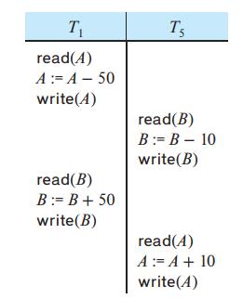

View Serializability
It is possible to have two schedules that produce the same outcome but that are not conflict equivalent.
How to show the equivalency?
This schedule is not conflict equivalent to the serial schedule <T1,T2> and hence not serializable
However, the final values of accounts A and B after the execution of either the above schedule or the serial schedule <T1,T2> are the same—$960 and $2040, respectively.

Slide 28
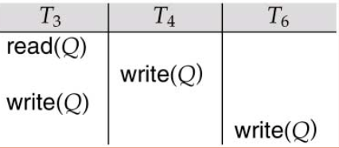
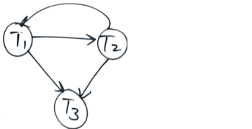
View Serializability
Conflict Precedence Graph
The above graph contains cycle/loop which means it is not conflict-serializable but it does not mean that it cannot be consistent and equivalent to the serial schedule it may or may not be.

Slide 29
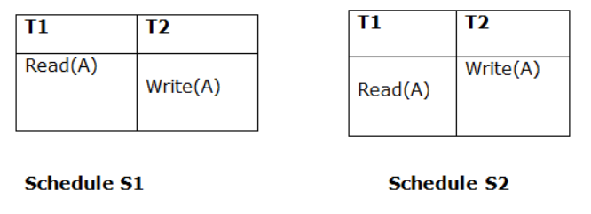

View Serializability
Let S and S´ be two schedules with the same set of transactions. S and S´ are view equivalent if the following three conditions are met, for each data item Q,
If in schedule S, transaction $T_{i}$ reads the initial value of Q, then in schedule S’ also transaction $T_{i}$ must read the initial value of Q.

Slide 30
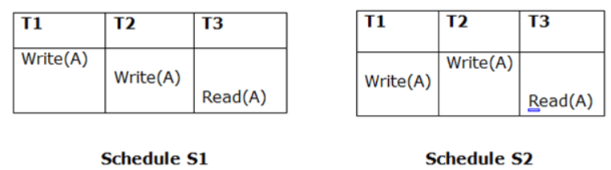
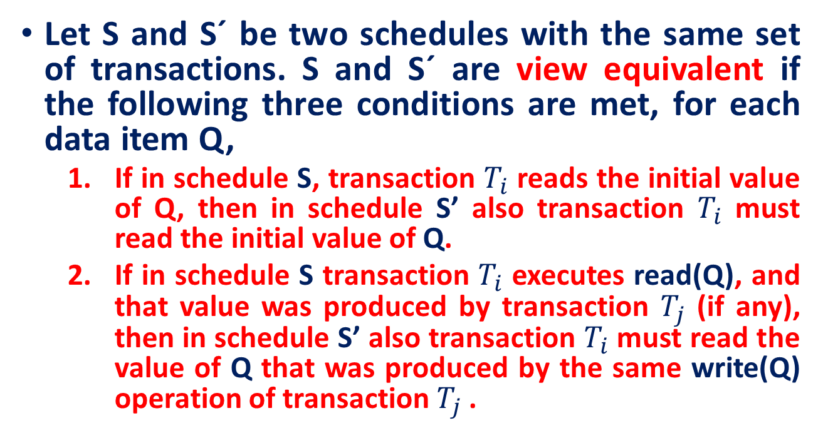
View Serializability
Let S and S´ be two schedules with the same set of transactions. S and S´ are view equivalent if the following three conditions are met, for each data item Q,
If in schedule S, transaction $T_{i}$ reads the initial value of Q, then in schedule S’ also transaction $T_{i}$ must read the initial value of Q.
If in schedule S transaction $T_{i}$ executes read(Q), and that value was produced by transaction $T_{j}$ (if any), then in schedule S’ also transaction $T_{i}$ must read the value of Q that was produced by the same write(Q) operation of transaction $T_{j}$ .
Not satisfying Point 2

Slide 31
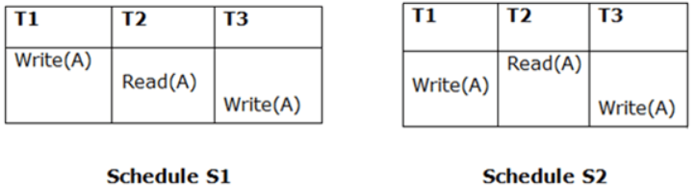
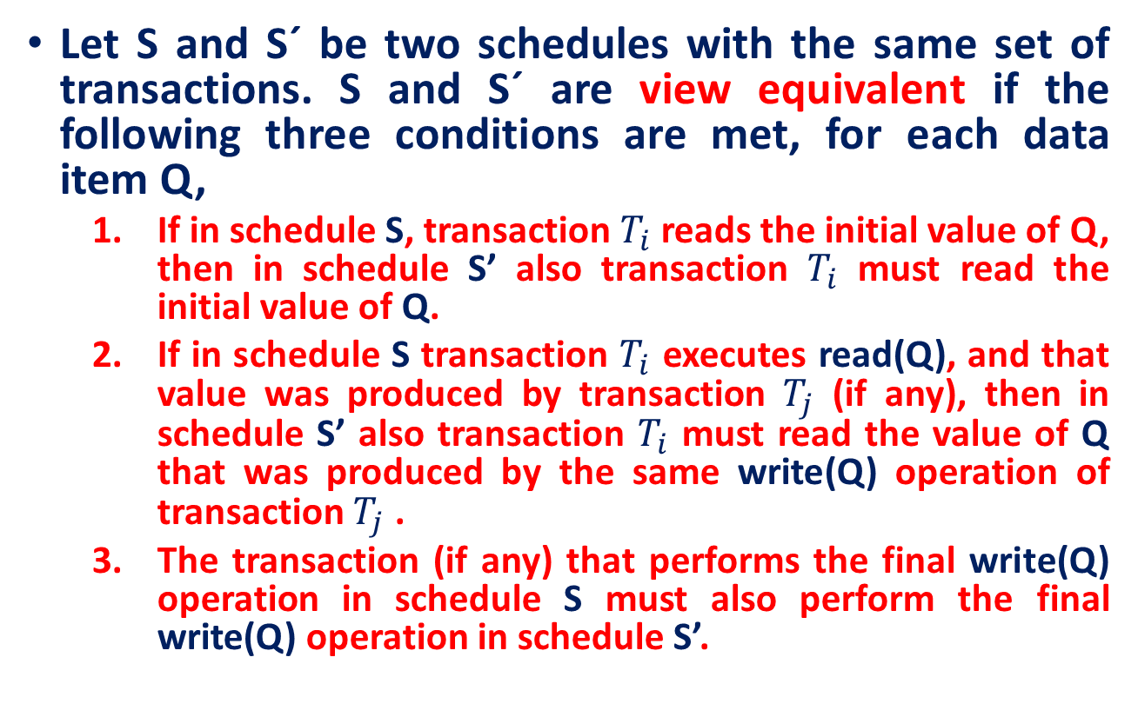
View Serializability
Let S and S´ be two schedules with the same set of transactions. S and S´ are view equivalent if the following three conditions are met, for each data item Q,
If in schedule S, transaction $T_{i}$ reads the initial value of Q, then in schedule S’ also transaction $T_{i}$ must read the initial value of Q.
If in schedule S transaction $T_{i}$ executes read(Q), and that value was produced by transaction $T_{j}$ (if any), then in schedule S’ also transaction $T_{i}$ must read the value of Q that was produced by the same write(Q) operation of transaction $T_{j}$ .
The transaction (if any) that performs the final write(Q) operation in schedule S must also perform the final write(Q) operation in schedule S’.

Slide 32
View Serializability
A schedule S is view serializable if it is view equivalent to a serial schedule.
Every conflict serializable schedule is also view serializable.

Slide 33
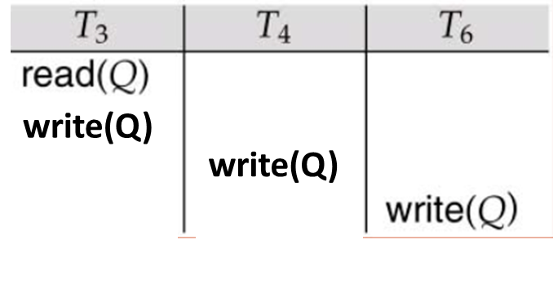
View Serializability

Slide 34
Test for View Serializability!
The precedence graph test for conflict serializability cannot be used directly to test for view serializability.
Extension to test for view serializability has cost exponential in the size of the precedence graph.
The problem of checking if a schedule is view serializable falls in the class of NP-complete problems.
Thus, existence of an efficient algorithm is extremely unlikely.
However practical algorithms that just check some sufficient conditions for view serializability can still be used.

Slide 35
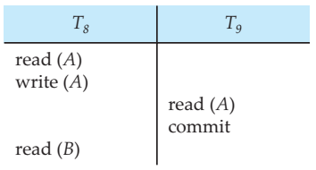
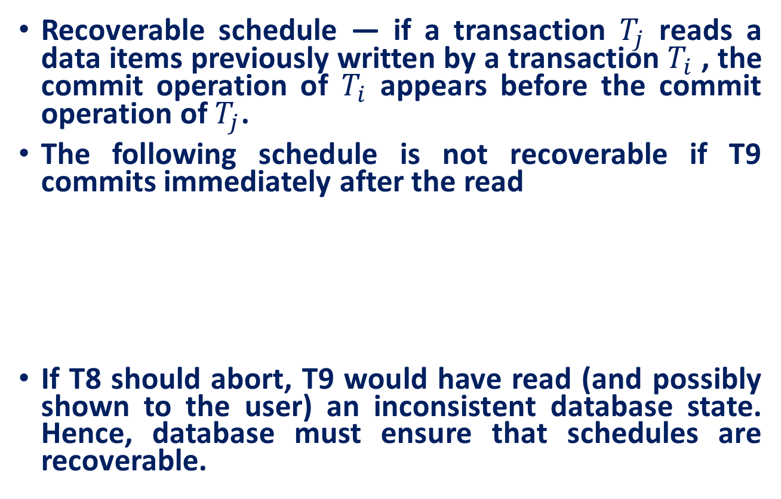
Recoverability
Recoverable schedule — if a transaction $T_{j}$ reads a data items previously written by a transaction $T_{i}$ , the commit operation of $T_{i}$ appears before the commit operation of $T_{j}$.
The following schedule is not recoverable if T9 commits immediately after the read
If T8 should abort, T9 would have read (and possibly shown to the user) an inconsistent database state. Hence, database must ensure that schedules are recoverable.

Slide 36
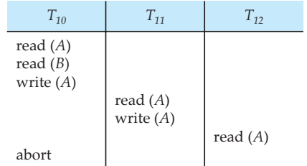
Cascading Rollbacks
Cascading rollback – a single transaction failure leads to a series of transaction rollbacks. Consider the following schedule where none of the transactions has yet committed (so the schedule is recoverable)
If T10 fails, T11 and T12 must also be rolled back.

Slide 37
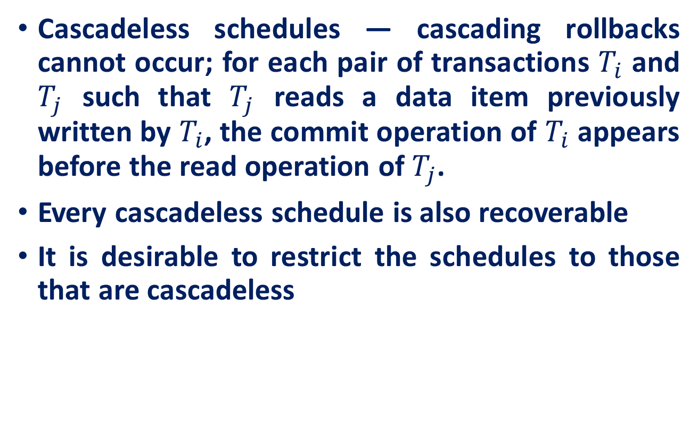
Cascadeless Schedules!
Cascadeless schedules — cascading rollbacks cannot occur; for each pair of transactions $T_{i}$ and $T_{j}$ such that $T_{j}$ reads a data item previously written by $T_{i}$, the commit operation of $T_{i}$ appears before the read operation of $T_{j}$.
Every cascadeless schedule is also recoverable
It is desirable to restrict the schedules to those that are cascadeless

Slide 38
Concurrency Control
Schedules must be conflict or view serializable, and recoverable, for the sake of database consistency, and preferably cascadeless.
A policy in which only one transaction can execute at a time generates serial schedules, but provides a poor degree of concurrency.
Concurrency-control schemes tradeoff between the amount of concurrency they allow and the amount of overhead that the incur.
Some schemes allow only conflict-serializable schedules to be generated, while others allow view-serializable schedules that are not conflict-serializable.

Slide 39
References
Abraham Silberschatz, Henry F. Korth, and S. Sudarshan, Database System Concepts, 7/e
Adhsakkdi Y, Raghuram Krishnan and Johannes Gehrke, Database Management Systems, 3/e, TMH, 2007.
Some of the figures and Examples are taken from various online sources.

